Slide 1
Key Questions
How can a continuous wave form be converted into discrete samples?
How can discrete samples be converted back into a continuous form?

Slide 2
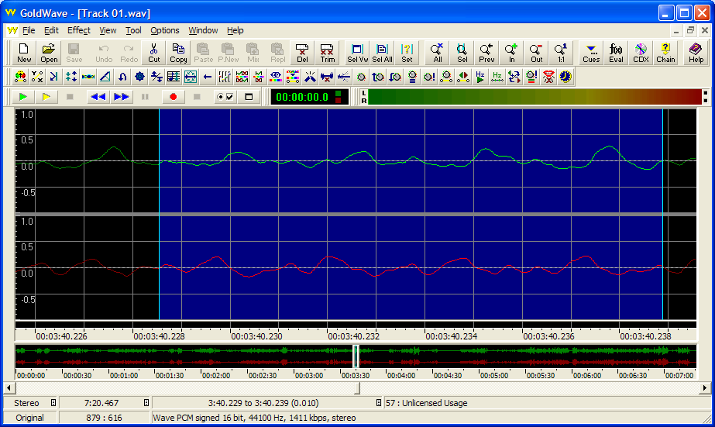
Characteristics of Sound
Amplitude
Wavelength (w)
Frequency ( )
Timbre
Hearing: [20Hz – 20KHz]
Speech: [200Hz – 8KHz]

Slide 3
Digital Representation of Audio
Must convert wave form to digital
sample
quantize
compress

Slide 4
Sampling (in time)
Measure amplitude at regular intervals
How many times should we sample?

Slide 5
Example
Suppose we have a sound wave with a frequency of 1 cycle per second

Slide 6
Example
If we sample at one cycle per second, where would the sample points fall?

Slide 7
Example
If we sample at 1.5 cycles per second, where will the sample points fall?

Slide 8
Sampling - Example
If we sample at two cycles per second, where do the sample points fall?

Slide 9
Nyquist Theorem
For lossless digitization, the sampling rate should be at least twice the maximum frequency response.
In mathematical terms:
f_{s} > 2*f_{m}
where f_{s} is sampling frequency and f_{m} is the maximum frequency in the signal

Slide 10
Nyquist Limit
max data rate = 2 H log₂V bits/second, where H = bandwidth (in Hz) V = discrete levels (bits per signal change)
Shows the maximum number of bits that can be sent per second on a noiseless channel with a bandwidth of H, if V bits are sent per signal
Example: what is the maximum data rate for a 3kHz channel that transmits data using 2 levels (binary) ?
(2x3,000xln2=6,000bits/second)

Slide 11
Limited Sampling
But what if one cannot sample fast enough?

Slide 12
Limited Sampling
Reduce signal frequency to half of maximum sampling frequency
low-pass filter removes higher-frequencies
e.g., if max sampling frequency is 22kHz, must low-pass filter a signal down to 11kHz

Slide 13
Sampling Ranges
Auditory range 20Hz to 22.05 kHz
must sample up to to 44.1kHz
common examples are 8.000 kHz, 11.025 kHz, 16.000 kHz, 22.05 kHz, and 44.1 KHz
Speech frequency [200 Hz, 8 kHz]
sample up to 16 kHz
but typically 4 kHz to 11 kHz is used

Slide 14
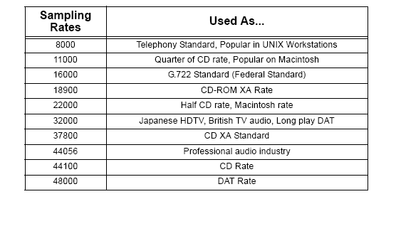

Slide 15
Quantization

Slide 16
Quantization
Typically use
8 bits = 256 levels
16 bits = 65,536 levels
How should the levels be distributed?
Linearly? (PCM)
Perceptually? (u-Law)
Differential? (DPCM)
Adaptively? (ADPCM)

Slide 17
Pulse Code Modulation
Pulse modulation
Use discrete time samples of analog signals
Transmission is composed of analog information sent at different times
Variation of pulse amplitude or pulse timing allowed to vary continuously over all values
PCM
Analog signal is quantized into a number of discrete levels

Slide 18
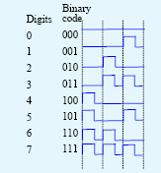
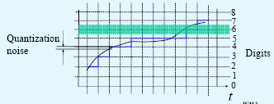
PCM Quantization and Digitization
Digitization
Quantization

Slide 19
Linear Quantization (PCM)
Divide amplitude spectrum into N units (for log₂N bit quantization)
Quantization Index
Sound Intensity

Slide 20

Non-uniform Quantization

Slide 21
Perceptual Quantization (u-Law)
Want intensity values logarithmically mapped over N quantization units
Quantization Index
Sound Intensity

Slide 22
Differential Pulse Code Modulation (DPCM)
What if we look at sample differences, not the samples themselves?
d_{t} = x_{t}-x_{t-1}
Differences tend to be smaller
Use 4 bits instead of 12, maybe?

Slide 23
Differential Quantization (DPCM)
Changes between adjacent samples small
Send value, then relative changes
value uses full bits, changes use fewer bits
E.g., 220, 218, 221, 219, 220, 221, 222, 218,.. (all values between 218 and 222)
Difference sequence sent: 220, +2, -3, 2, -1, -1, 3, ..
Result: originally for encoding sequence 0..255 numbers need 8 bits;
Difference coding: need only 3 bits

Slide 24
Adaptive Differential Pulse Code Modulation (ADPCM)
Adaptive similar to DPCM, but adjusts the width of the quantization steps
Encode difference in 4 bits, but vary the mapping of bits to difference dynamically
If rapid change, use large differences
If slow change, use small differences

Slide 25
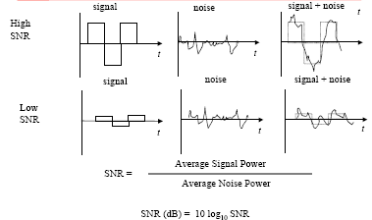
Signal-to-Noise Ratio

Slide 26
Signal To Noise Ratio
Measures strength of signal to noise
SNR (in DB)=
Given sound form with amplitude in [-A, A]
Signal energy =
A
0
-A

Slide 27
Quantization Error
Difference between actual and sampled value
amplitude between [-A, A]
quantization levels = N
e.g., if A = 1, N = 8, = 1/4

Slide 28
Data Rates
Data rate = sample rate * quantization * channel
Compare rates for CD vs. mono audio
8000 samples/second * 8 bits/sample * 1 channel = 8 kBytes / second
44,100 samples/second * 16 bits/sample * 2 channel = 176 kBytes / second ~= 10MB / minute

Slide 29
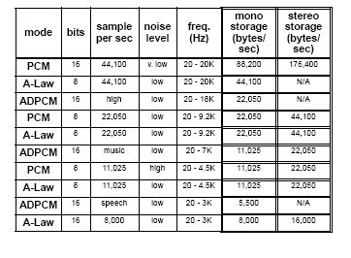
Comparison and Sampling/Coding Techniques

Slide 30
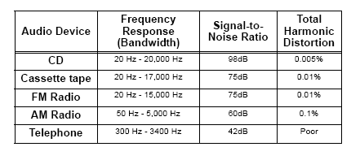
Summary

